Slide 1
Sentimental Analysis of
Real-Time Tweets
Under guidance of
Dr Animesh Chathurvedi
DS309

Slide 2



Problem Statement
Introduction
CONTENTS :
About Dataset
Exploration of models
Web interface

Slide 3
PROBLEM STATEMENT :
In the contemporary landscape of social media, sentiment analysis can help any organization to find people's opinions of their company and products . Our project aims to develop effective model for sentiment analysis on a twitter dataset. We have performed comparative analysis of traditional machine learning approaches , RNN architecture and advanced pretrained model and selected the most efficient and accurate model among these models . We have also provided a user-friendly web interface for real-time sentiment prediction.

Slide 4
INTRODUCTION:
Sentiment Analysis is the technique used for determining the nature of any text by applying various text analysis methods. Sentiment analysis can broadly divide the emotion of any text in these three categories which are Positive, Neutral and Negative. The rise in no. of Online users on the internet using the social media platforms to post their reviews, feedbacks or opinions in general about other People or Organizations. These opinions create an image of any organization or how everyone feels about them.

Slide 5


ABOUT DATASET :
DATASET :
About -Analysis of Public Sentiment on Narendra Modi and Other Leaders
Context: Insights from the 2019 Indian General Elections
Our dataset consists of tweets posted on twitter of political leader Modi .The count of the tweets are 1,63,000 (approx) . All these Tweets were extracted using there Respective Apis Tweepy and PRAW .Tweets from twitter are cleaned using Pythons re and also NLP with a Sentimental Label to each ranging from -1 to 1.
Data Visualization :
Data Preprocessing :
We visualized data into three representations ;
Bar graph
Pie chart
Wordclouds
Our dataset preprocessing includes steps ;
Stopwords
Word tokenize
WordNetLemmatizer

Slide 6
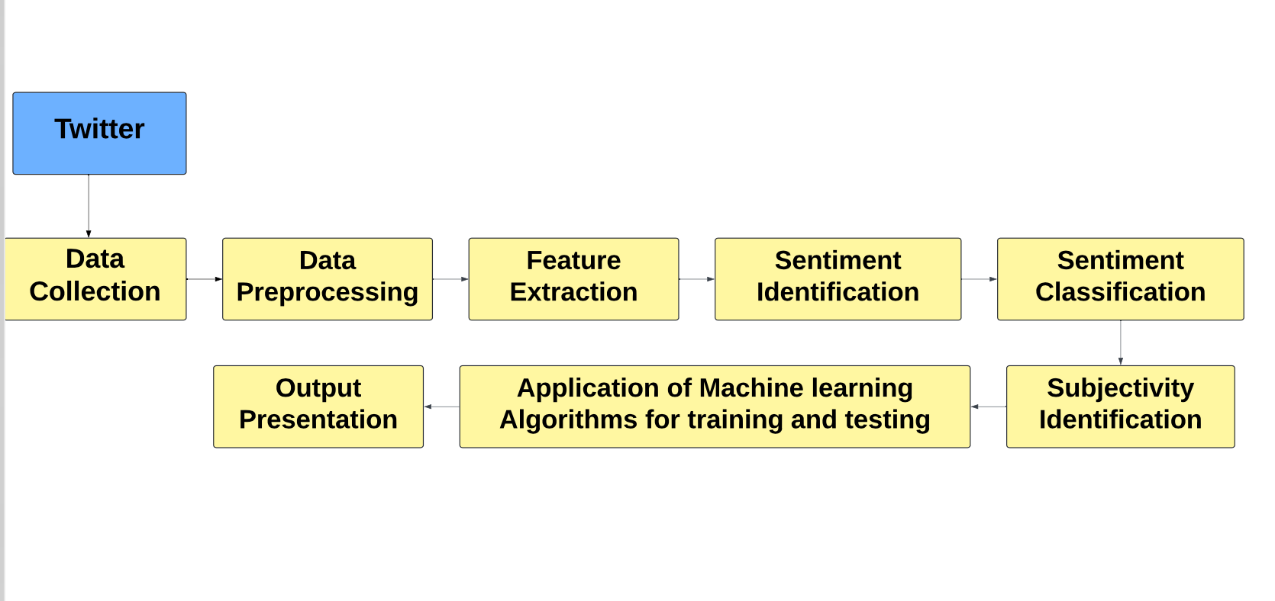
Flowchart of Real-Time Sentiment Analysis on Twitter Data

Slide 7


EXPLORATION OF MODELS :
Our main objective of this project is to find the model which is most efficient and accurate in classifying the sentiments of the tweets into three categories like positive, negative and neutral .
So for this accurate classification we chose the models from machine learning, RNN architecture and advanced pretrained models like :
Naive Bayes Classifier 2. Bag of Words Vectorization-based model
3. LSTM-Long Short Term Memory 4. BERT
For github link
CLICK HERE
For colab link
CLICK HERE

Slide 8
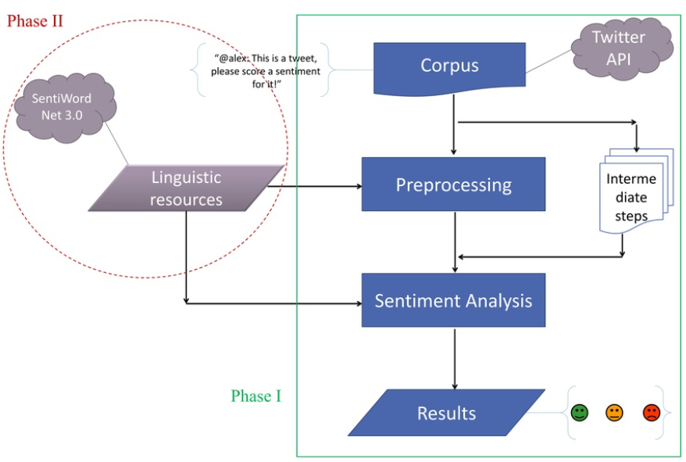
NAIVE BAYES CLASSIFIER :
The Naive Bayes Classifier is a probabilistic machine learning algorithm widely used for classification tasks, especially in natural language processing (NLP) and text classification.
Naive Bayes categorizes text into sentiment classes such as positive, negative, or neutral by calculating the likelihood of observing certain words given the sentiment label.
Naive Bayes often performs surprisingly well in text classification tasks, spam filtering, and sentiment analysis.

Slide 9

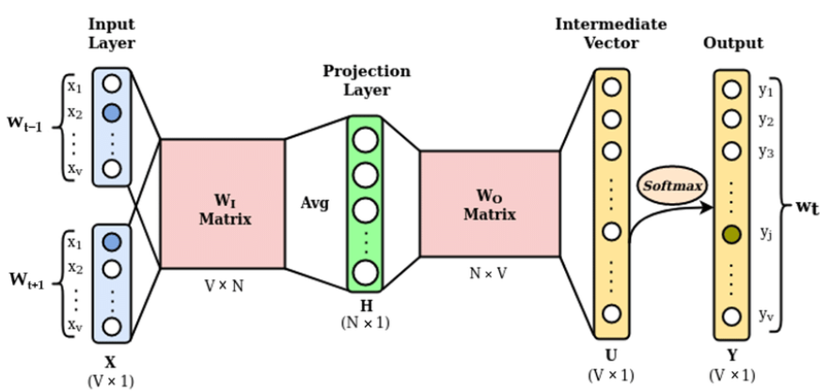
BAG OF WORDS :
The Bag of Words(BoW) is a fundamental concept in natural language processing (NLP). Unlike more complex models that consider syntax and semantics, BoW represents text as an unordered collection of words, treating each document as a "bag" with its word frequency distribution.
BoW vectorization using techniques like CountVectorizer converts text data into numerical representations by counting the occurrences of words in each document, making it suitable for capturing the overall word frequency distribution and identifying sentiment patterns.

Slide 10
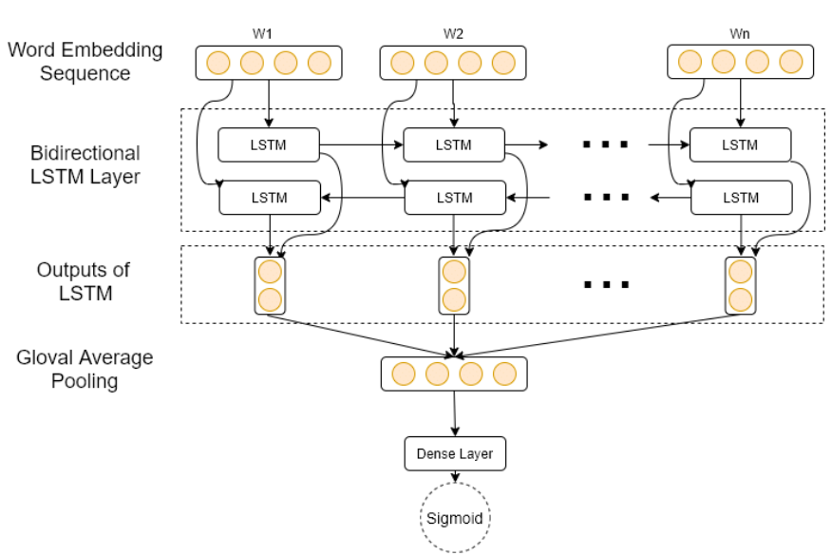
LSTM NETWORK (RNN) :
Long Short-Term Memory (LSTM) networks are a specialized type of recurrent neural network (RNN) designed to capture long-range dependencies in sequential data.
LSTM is chosen for its proficiency in capturing sequential dependencies in text data, essential for understanding the flow of sentiment in sentences.

Slide 11
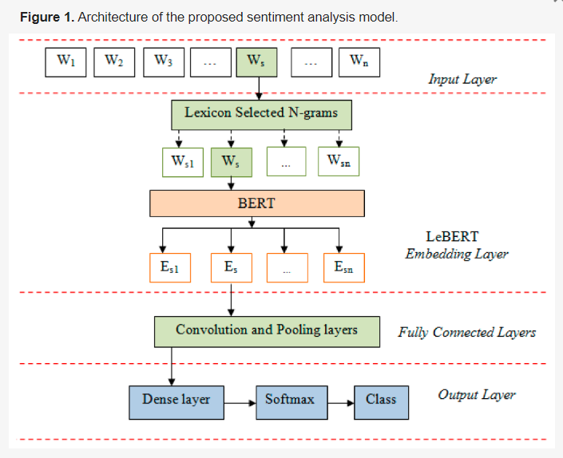
BERT-PRETRAINED MODEL :
BERT utilizes a bidirectional transformer architecture, enabling it to capture contextual information from both left and right contexts of words in a sentence.
This unique architecture enables BERT to effectively model long-range dependencies and subtle nuances in language, empowering it to analyze sentiment across diverse datasets and contexts.

Slide 12
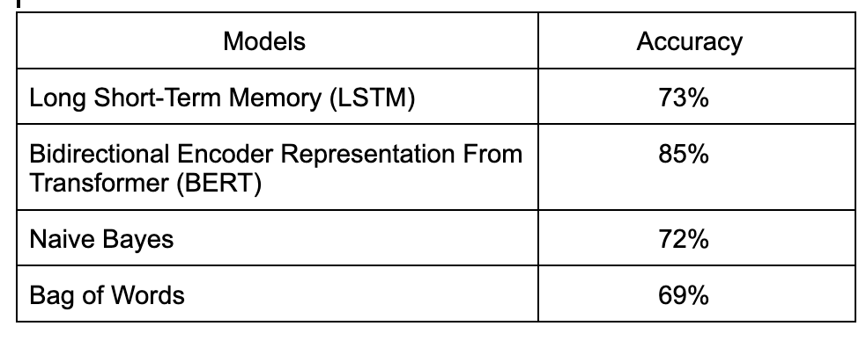
Comparative Analysis of models :

Slide 13
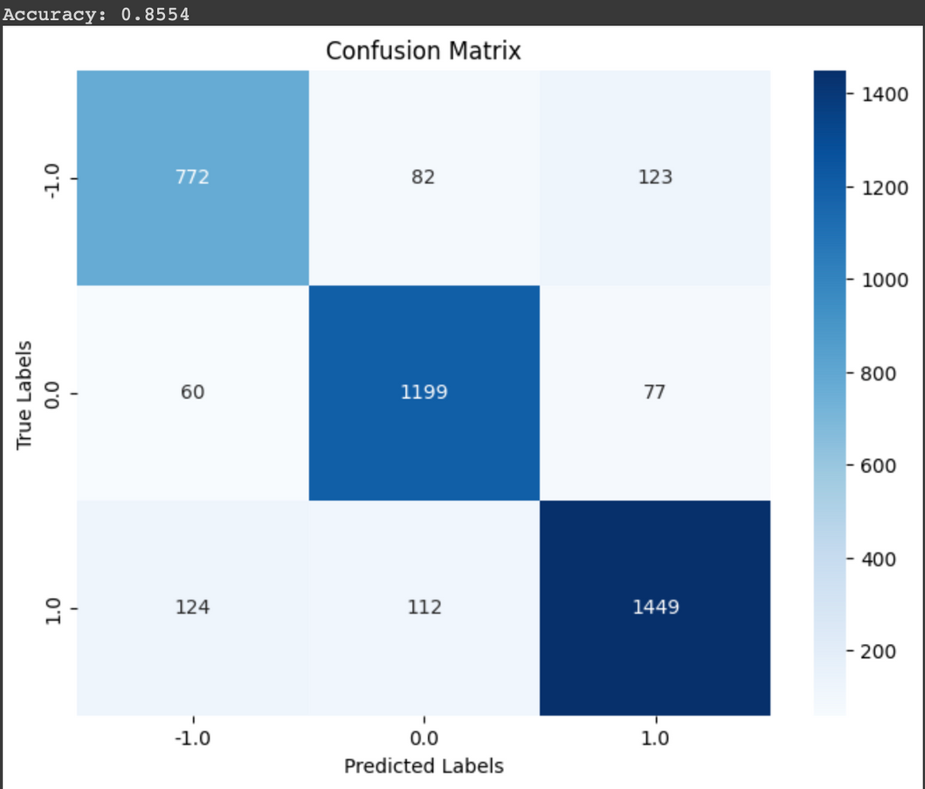
RESULTS :
From the previous slide we can observe that BERT model has highest accuracy compared to other models in the table .
As BERT model got the accuracy of 85% we consider this model as most efficient and accurate in classifying the sentiments through the tweets data .

Slide 14
CONCLUSION :
In this project, we conducted sentiment analysis on real-time Twitter data using machine learning models. Through experimentation, we found that the BERT model demonstrated the highest accuracy in sentiment prediction and we also utilized Flask to develop a user-friendly web interface.
By integrating API calls, the web interface dynamically accesses the BERT model code, enabling real-time sentiment prediction on input tweets.
This study contributes to the ongoing development of sentiment analysis models by showcasing the practical effectiveness of advanced deep learning architectures, such as BERT, in accurately capturing and interpreting the subtle variations of sentiment present in large-scale social media datasets.

Slide 15
Team Members
A.Saras Chandrika (21BDS003)
Chandana.R (21BDS010)
G.Thanmai (21BDS033)

Slide 16
Thank you!

